Slide 1



Department of Computer Science and Engineering
MACHINE LEARNING BASED PHISHING URL CYBERCRIME DETECTION
DOMMARAJU POOJITHA (211419104074)
KEERTHIKA R (211419104136)
PONNA SOWMYA REDDY (211419104190)
Guide Name & Designation
DR.K.SANGEETHA,M.E.,PH.D.,
Coordinator Name & Designation
DR.KAVITHA SUBRAMANI,M.E.,PH.D.,

Slide 2
ABSTRACT
Phishing attack is a simplest way to obtain sensitive information from innocent users. Aim of the phishers is to acquire critical information like username, password and bank account details. Cyber security persons are now looking for trustworthy and steady detection techniques for phishing websites detection. This paper deals with machine learning technology for detection of phishing URLs by extracting and analyzing various features of legitimate and phishing URLs. Logistic Regression, Random Forest and Support vector machine algorithm,…..etc are used to detect phishing websites. Aim of the paper is to detect phishing URLs as well as narrow down to best machine learning algorithm by comparing accuracy rate, false positive and false negative rate of each algorithm.

Slide 3
Literature Survey
S. NO | YEAR | AUTHOR (S) | PROJECT DETAILS | METHODOLOGIES | MERITS AND DEMERITS | FUTURE SCOPE
1 | 2021 | Abhijit Sharma | TITLE: Lexical Feature Based Feature Selection and Phishing URL Classification Using Machine Learning Techniques. | Feature selection techniques have been used. ACCURACY : 90% | MERIT: Performances are analyzed for different datasets with various parameters using four different machine learning techniques. DEMERIT: In this phishing and legitimate URL classifications are performed only based on the lexical features of URLs but not content features and host based features of URLs. | Detect system with a wide protection scope using URL features only which is relying on the fact that users directly deal with URLs to surf the internet and provides a good approach to detect malicious URLs.

Slide 4
Literature Survey
S. NO | YEAR | AUTHOR (S) | PROJECT DETAILS | METHODOLOGIES | MERITS AND DEMERITS | FUTURE SCOPE
2 | 2021 | Mohammad Hijjil And Gulzar Alam | TITLE: A Multivocal Literature Review on Growing Social Engineering Based Cyber-Attacks/Threats During the COVID-19 Pandemic: Challenges and Prospective Solutions. | Systematic literature mappings(SLM), Systematic literature review(SLR), Grey literature mapping (GLM), Grey literature review(GLR), Multivocal literature mapping(MLM), Multivocal literature review(MLR). ACCURACY : 90.06% | MERIT: They identified the open challenges, general recommendations, and prospective solutions for future work from the researcher and practitioner communities by using the latest technology, such as artificial intelligence, blockchain, and big data analytics. DEMERIT: It only focussed on frequently used malicious software. | It integrates into such process in order to increase the detection performance in a real time.

Slide 5
Literature Survey
S. NO | YEAR | AUTHOR (S) | PROJECT DETAILS | METHODOLOGIES | MERITS AND DEMERITS | FUTURE SCOPE
3 | 2020 | Mehmet Korkmaz | TITLE: Detection of Phishing Websites by Using Machine Learning-Based URL Analysis | Decision tree and Random forest ACCURACY : 91.4% | MERIT: The algorithm used in this project is random forest algorithm, it has better MSE value, when it is compared with other machine learning classifier algorithms. Since the random forest algorithm has least MSE value, it significantly increases the accuracy of Phishing attack detection. DEMERIT: This project only compared few machine learning frameworks and took best from that. | Secure email gateway’s (SEG’s) and phishing awareness training remain a critical tool in the fight against phishing and malware.

Slide 6
Literature Survey
S. NO | YEAR | AUTHOR (S) | PROJECT DETAILS | METHODOLOGIES | MERITS AND DEMERITS | FUTURE SCOPE
4 | 2020 | V. V. Ramalingam, Paras Yadav, Prakhar Srivastava | TITLE: Detection of Phishing Websites using an Efficient Feature-Based Machine Learning Framework | Random forest algorithm ACCURACY : 93% | MERIT: This project is focussed mainly to catch the zero-day attacks. DEMERIT: The experimental results depict that the proposed models have an outstanding performance with a success rate but not perfect accuracy. | This not only improves security, but can significantly reduce the workloads of IT and security teams.

Slide 7
Literature Survey
S. NO | YEAR | AUTHOR (S) | PROJECT DETAILS | METHODOLOGIES | MERITS AND DEMERITS | FUTURE SCOPE
5 | 2020 | Ahmed Alzahrani | TITLE: Coronavirus Social Engineering Attacks: Issues and Recommendations | Support vector machine ACCURACY : 65.90% | MERIT: This project discusses the psychology behind social engineering and introduces security awareness as a solution to reduce the risk of social engineering attacks. DEMERIT: It provides only coronavirus social engineering attacks and provides recommendations for responding to such an attack. | These tools simply offer information and basic applications, automated and advanced phishing threat protection solutions can help solve the challenges that customers face.

Slide 8
Literature Survey
S. NO | YEAR | AUTHOR (S) | PROJECT DETAILS | METHODOLOGIES | MERITS AND DEMERITS | FUTURE SCOPE
6 | 2021 | Hyunsang Choi | TITLE: Detecting Malicious Web Links and Identifying Their Attack Types | Support vector machine(SVM), K-nearest neighbour(KNN) ACCURACY : 86.54% | MERIT: The accuracy was over 98% in detecting malicious URLs and over 93% in identifying attack types. DEMERIT: This project report their studies on the effectiveness of each group of discriminative features, and discuss their availability but not prevention of phishing. | It demonstrates that you have a pulse on the latest threats and an insight into how artificial intelligence and machine learning can improve the security posture, without adding more burden to them.

Slide 9
Literature Survey
S. NO | YEAR | AUTHOR (S) | PROJECT DETAILS | METHODOLOGIES | MERITS AND DEMERITS | FUTURE SCOPE
7 | 2019 | Kang leng chiew | TITLE: Building Standard Offline Anti-phishing Dataset for Benchmarking | List based and Heuristic based approaches(CANTINA). ACCURACY : 89.78% | MERIT: They conduct extensive experiments on a large-scale dataset and show a significant performance gain over existing methods. DEMERIT: This approach allows the model to capture several types of semantic information, but not syntactic information. | Classify algorithm and techniques to extract the phishing data sets criteria to classify their legitimacy.

Slide 10
Literature Survey
S. NO | YEAR | AUTHOR (S) | PROJECT DETAILS | METHODOLOGIES | MERITS AND DEMERITS | FUTURE SCOPE
8 | 2022 | Smiti Poddar; Harsh Salkar; Priya Agarwal; Deepak Karia; MilindParaye; Dayanand Ambawade; Narendra Bhagat | TITLE: Phish Guard - An Automatic Web Phishing Detection System | Support vector machine classification, Decision tree, Random forest, XGBoost, Natural Language Processing. ACCURACY : 87.21% | MERIT: It engage in a novel study into a phishing content classifier based on a recurrent neural network (RNN), which identifies such features without human input. DEMERIT: It identifies only common measurable features of phishing content but not all the features. | Internet security issues that target human vulnerabilities will be decreased.

Slide 11
Literature Survey
S. NO | YEAR | AUTHOR (S) | PROJECT DETAILS | METHODOLOGIES | MERITS AND DEMERITS | FUTURE SCOPE
9 | 2019 | T.Nathezhtha ; D.Sangeetha; V.Vaidehi | TITLE:WC-PAD: Web Crawling based Phishing Attack Detection | blacklist of DNS, Approach based on Heuristics and, Approach based on Web crawler. ACCURACY : 84.21% | MERIT: The project has the features like language independence, use of a huge size of phishing and legitimate data, real-time execution, detection of new websites, independence from third-party services and use of feature-rich classifiers. DEMERIT: Construction of new dataset requires additional bandwidth and memory. | Based on these features classification of phishing and non phishing websites are done.

Slide 12
Problem Statement
There are a number of users who purchase products online and make payments through e banking. There are e-banking websites that ask users to provide sensitive data such as username, password & credit card details, etc., often for malicious reasons. This type of e-banking website is known as a phishing website. Web service is one of the key communications software services for the Internet. Web phishing is one of many security threats to web services on the Internet.

Slide 13
Proposed System
We extended our previous dataset PILU-60K (Phishing Index Login URL) from 60K to 90K URLs equally distributed among three classes: phishing, the legitimate homepage, and legitimate login. We make this extended dataset, PILU-90K, publicly available for research purposes.
Using PILU-90K, we implemented and evaluated three pipelines for URL phishing detection: (i) we encounters. Depending on their input data, these approaches
Can be classified into two categories: URL-based and content based.

Slide 14
Hardware and Software used Hardware used
Hard Disk : 500GB and Above
RAM : 4GB and Above
Processor : I3 and Above
Webcam - 1
Software used
Operating System : Windows 10 (64 bit)
Software : Python
Tools : Anaconda

Slide 15
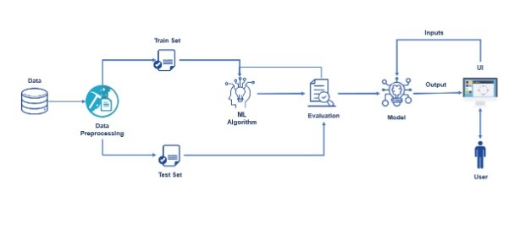
Architecture

Slide 16
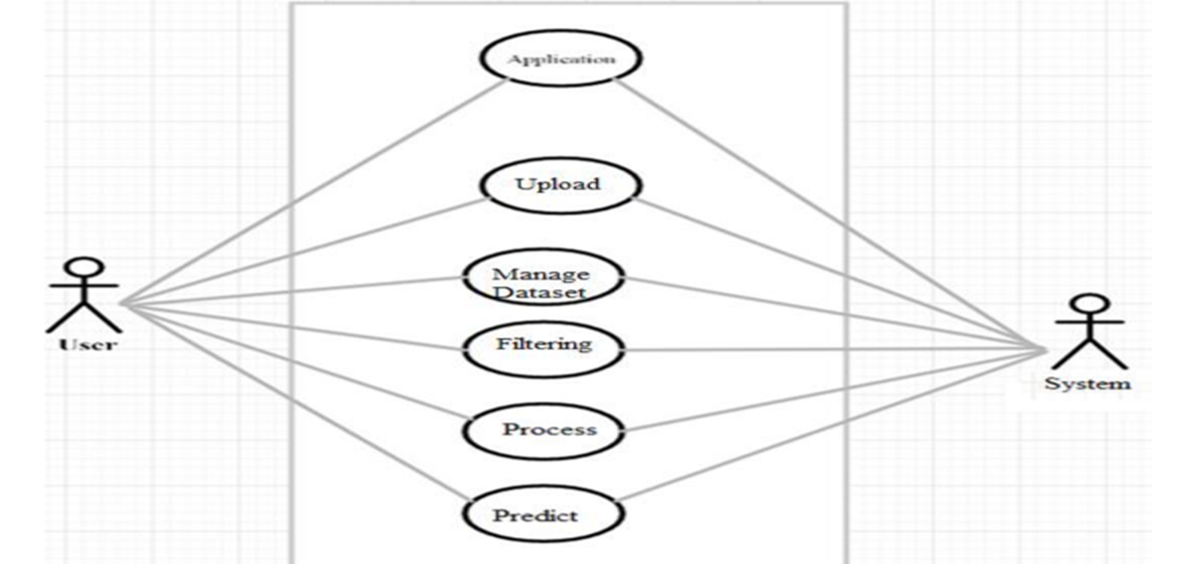
Usecase Diagram

Slide 17
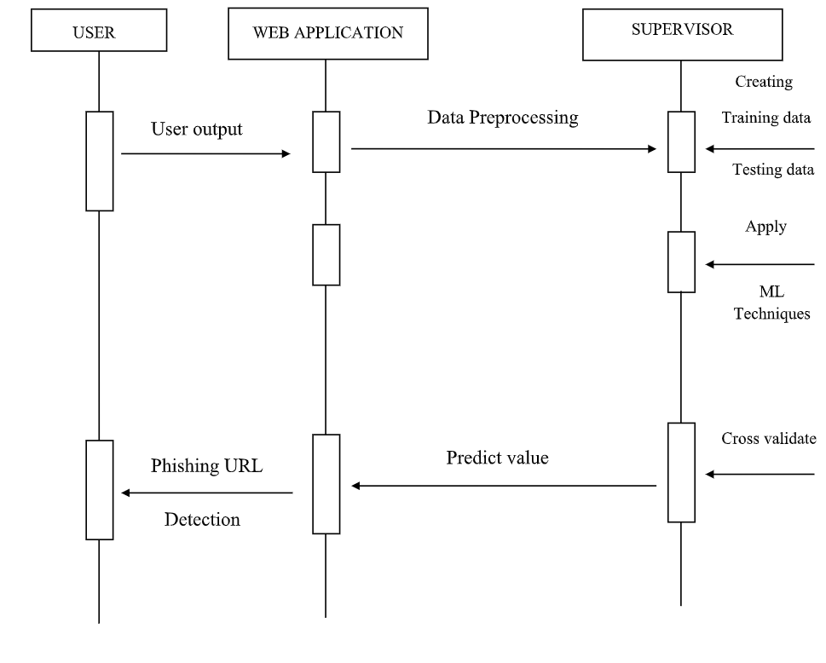
Sequence Diagram

Slide 18
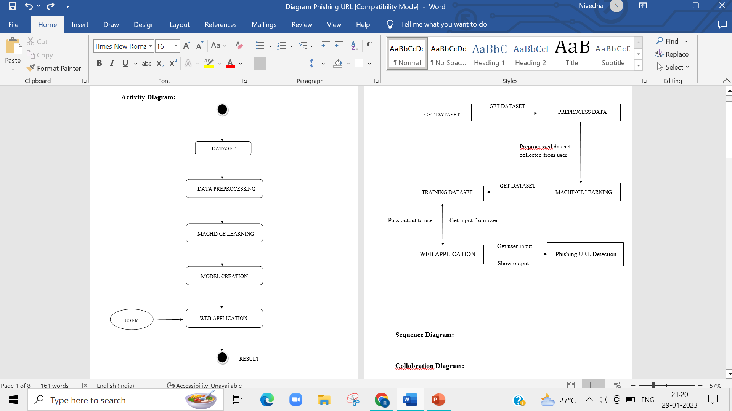
ACTIVITY DIAGRAM

Slide 19
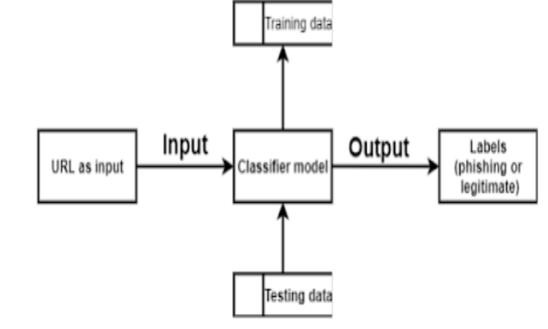
Data Flow Diagram – Level 0

Slide 20
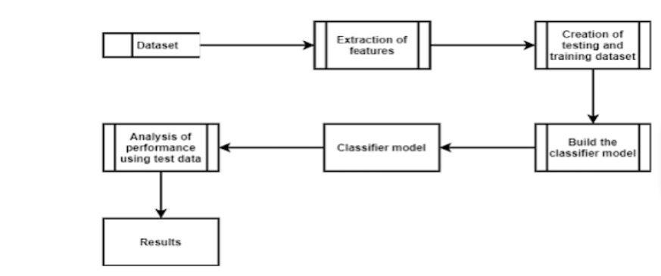
Data Flow Diagram – Level 1

Slide 21
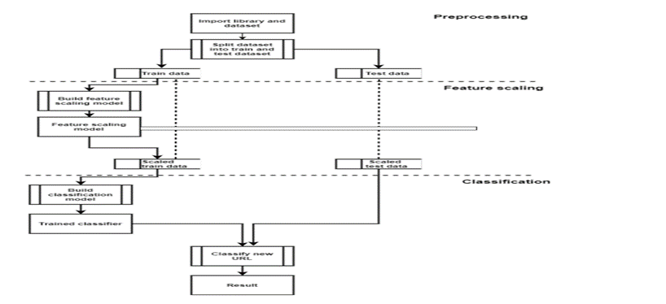
Data Flow Diagram – Level 2

Slide 22
Module Description
Dataset Collection
Algorithm Implementation
Detection

Slide 23
Dataset Collection
A machine learning dataset is a collection of data that is used to train the model. A dataset acts as an example to teach the machine learning algorithm how to make predictions.

Slide 24
Algorithm Implementation
LOGISTIC REGRESSION
Logistic regression is an example of supervised learning. It is used to calculate or predict the probability of a binary (yes/no) event occurring.
K-NEAREST NEIGHBOR
The K nearest neighbor algorithm, also known as KNN or K-NN, is a non-parametric, supervised learning classifier, which uses proximity to make classifications or predictions about the grouping of an individual data point
SUPPORT VECTOR CLASSIFIER
Support vector classifier a supervised machine learning model that uses classification algorithms for two-group classification problems.

Slide 25
Algorithm Implementation
NAIVE BAYES
Naive bayes is a supervised machine learning algorithm, which is used for classification tasks, like text classification.
RANDOM FOREST
Step 1: Select random samples from a given data or training set.
Step 2: This algorithm will construct a decision tree for every training data.
Step 3: Voting will take place by averaging the decision tree.
Step 4: Finally, select the most voted prediction result as the final prediction result.
ADABOOST ALGORITHM
AdaBoost algorithm, short for Adaptive Boosting, is a boosting technique, used as an ensemble method in machine learning. It is called Adaptive Boosting as the weights are re-assigned to each instance, with higher weights assigned to incorrectly classified instances.

Slide 26
Algorithm Implementation
LIGHT GBM
Light GBM is a fast, distributed, high-performance gradient boosting framework based on decision tree algorithm, used for ranking, classification and many other machine learning tasks.
GRADIENT BOOST
we use gradient boosting to solve classification and regression problems. It is a sequential ensemble learning technique where the performance of the model improves over iterations. This method creates the model in a stage-wise fashion.

Slide 27
DETECTION
After splitting the data into train and test we build the model and train it.
There are two major types of supervised machine learning problems, called classification and regression. Our data set comes under regression problem
The implementation of algorithms leads to the deduction of the result. The accurate outcome will be choosen as final result.

Slide 28
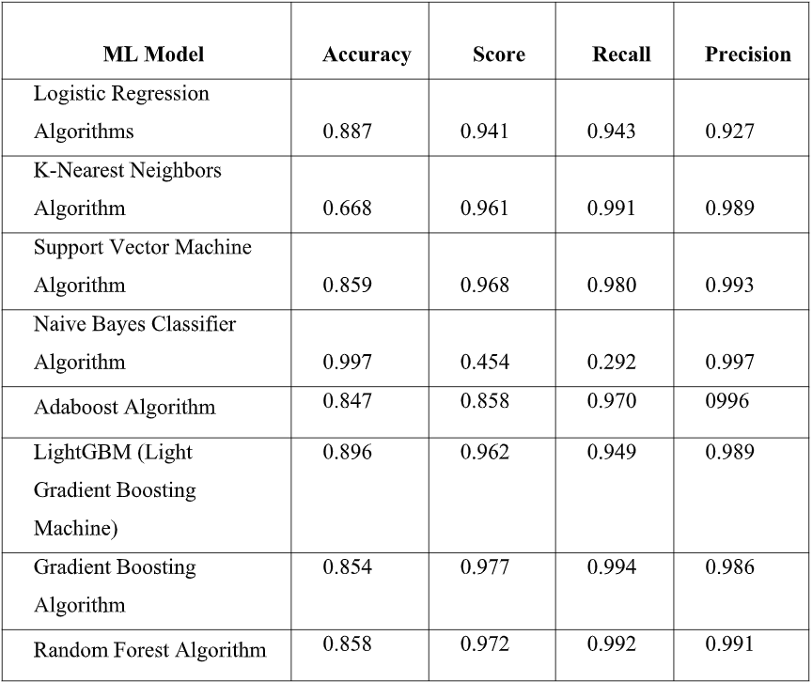
Performance Evaluation

Slide 29
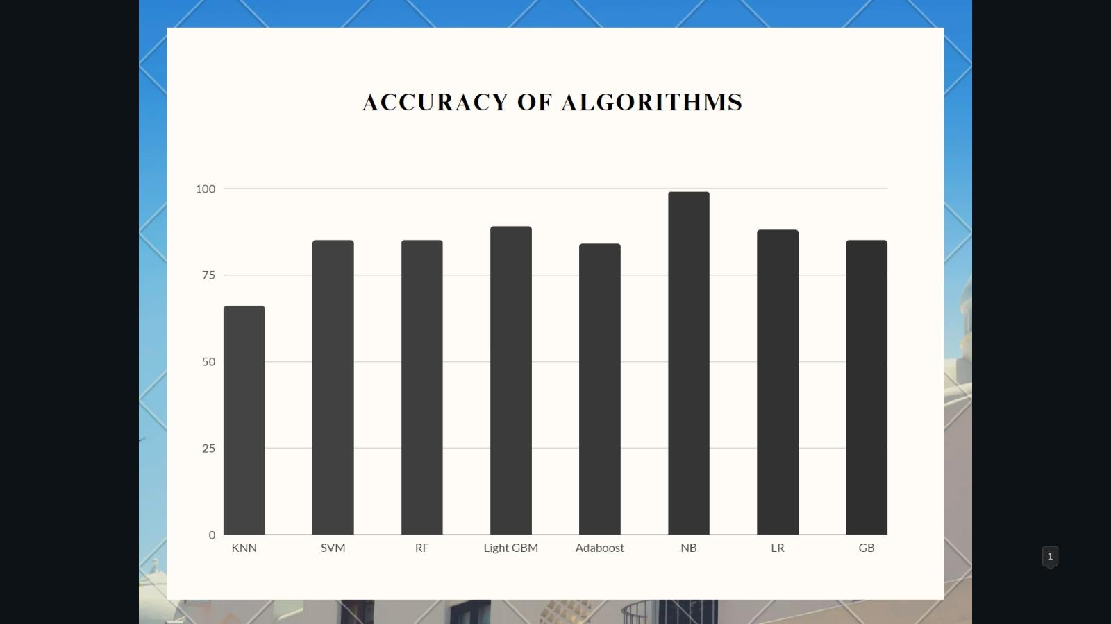
Performance Evaluation

Slide 30
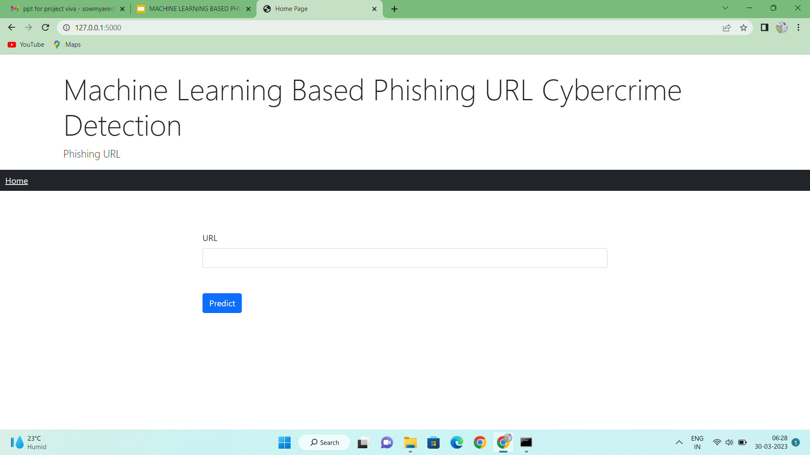
Screen Shots

Slide 31
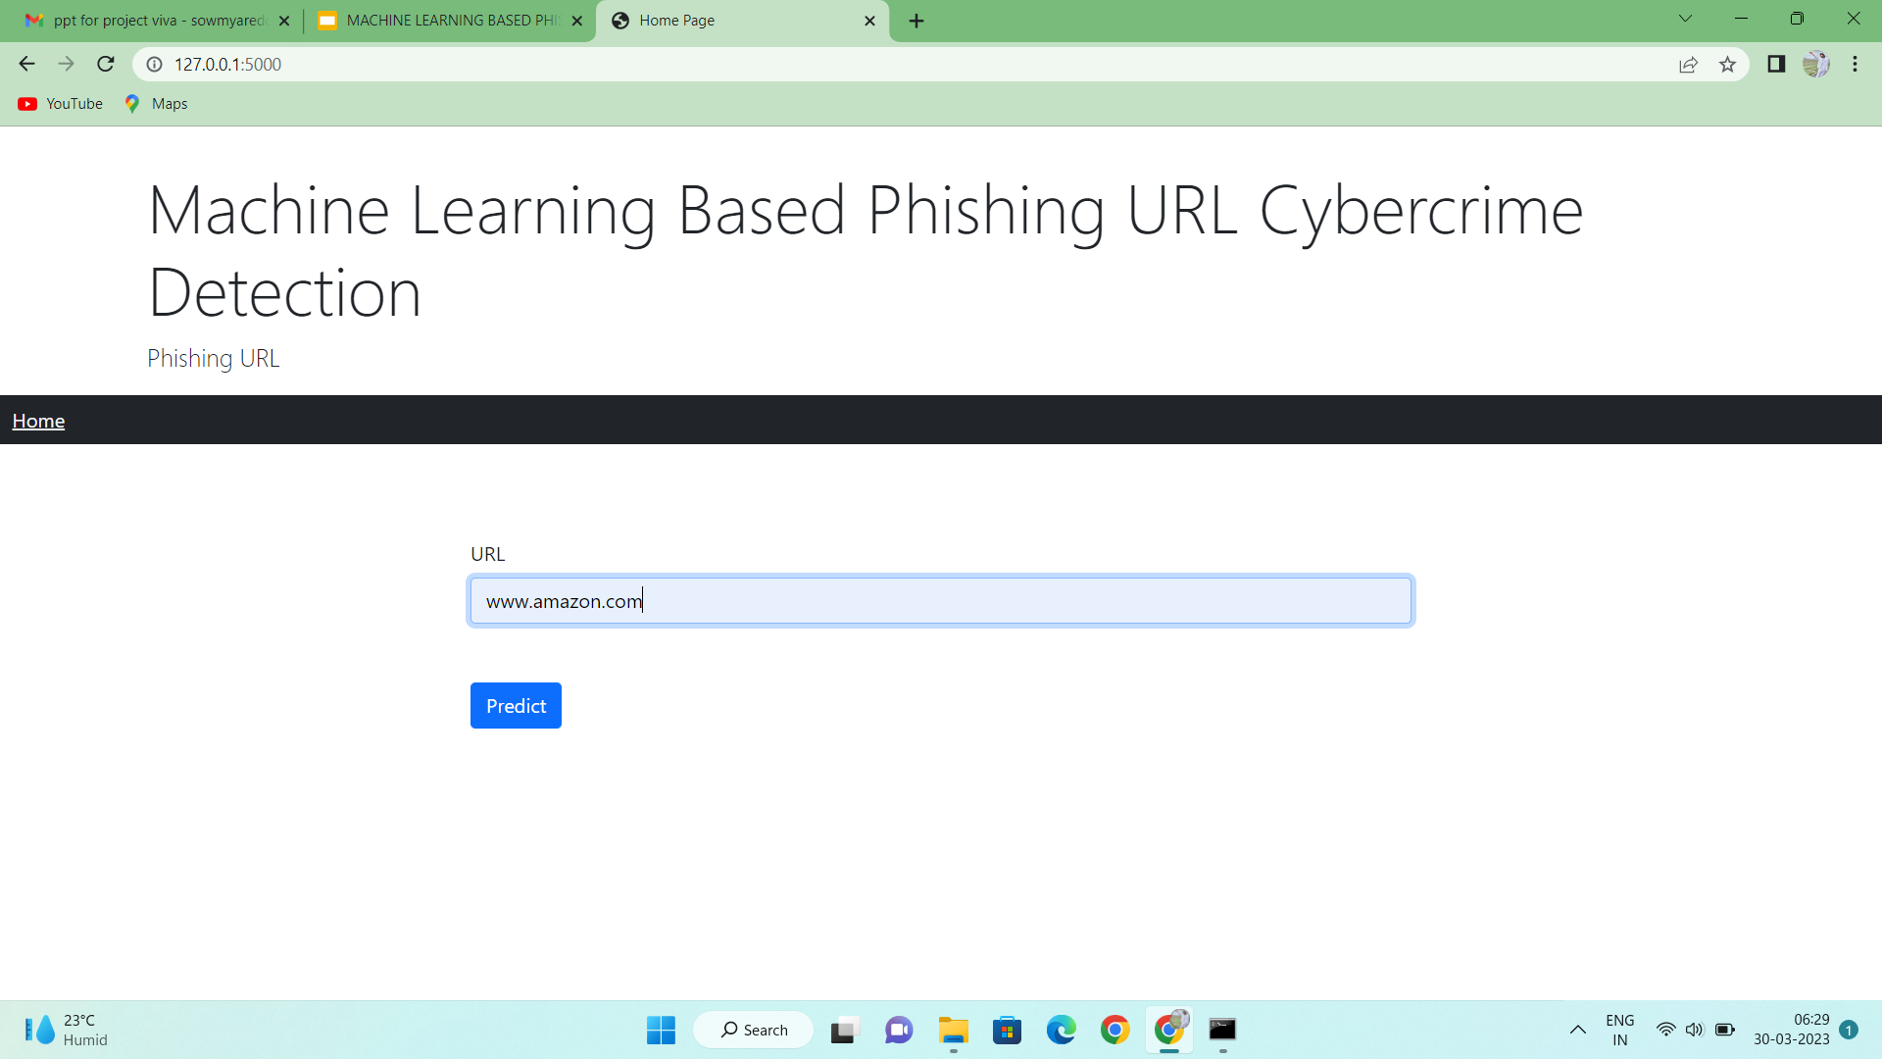
Screen Shots

Slide 32
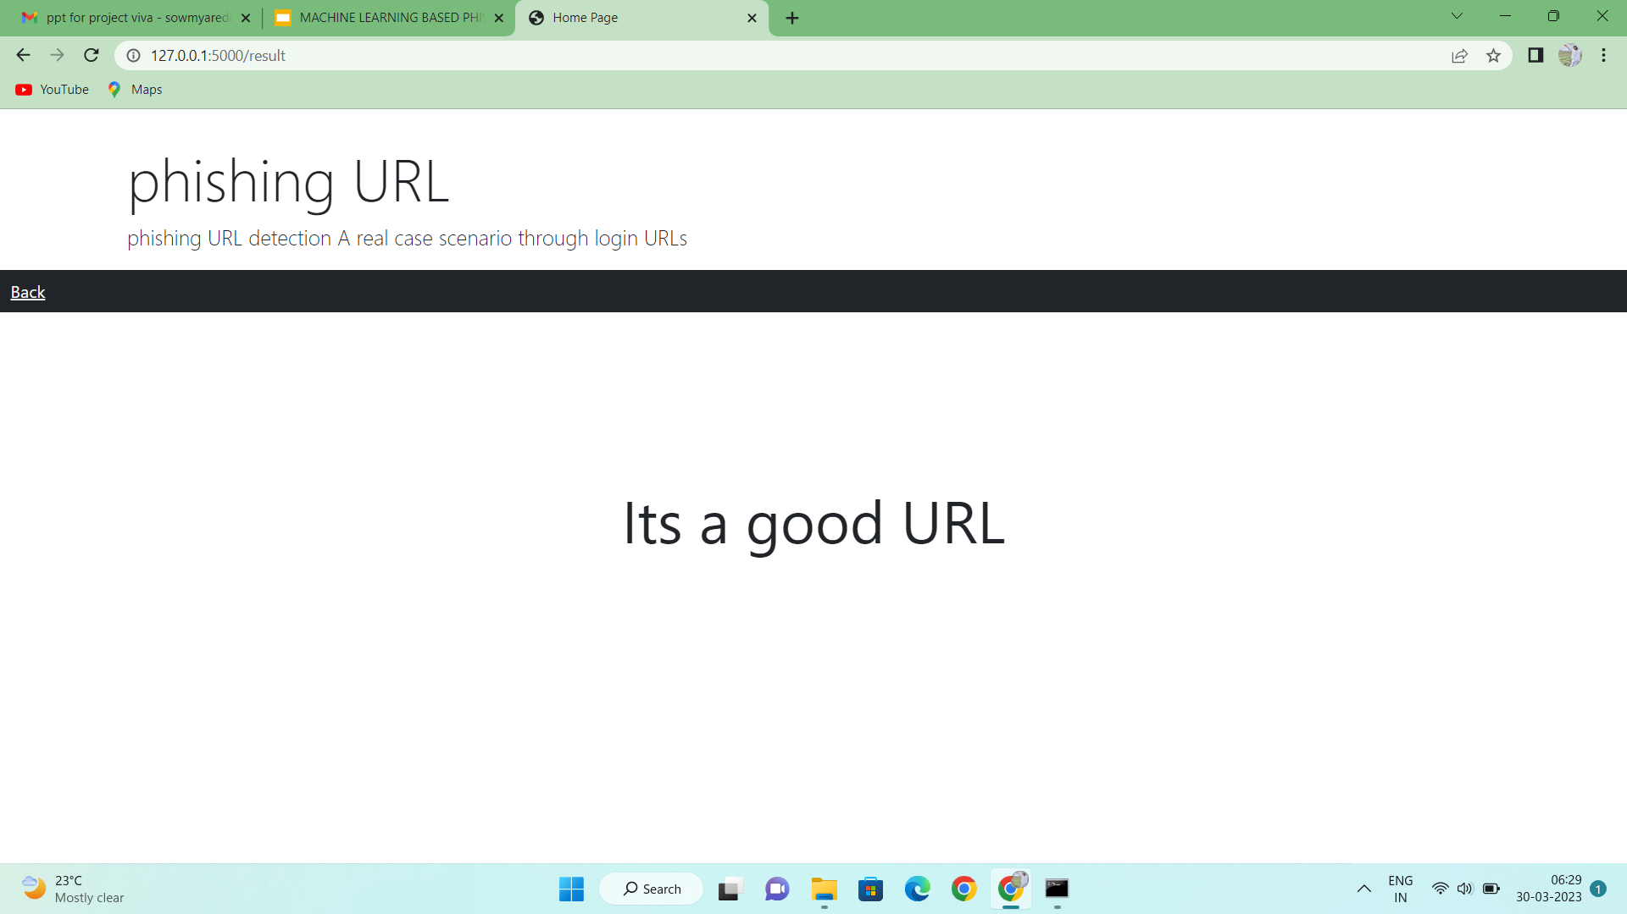
Screen Shots

Slide 33
Conclusion
Finally, we demonstrated that machine learning models using handcrafted URL features with increased performance, For this reason, machine learning methods should be trained with recent URLs to prevent substantial ageing from the date of its release.

Slide 34
Reference Paper/ URL
[1] Statista. (2020). Adoption Rate of Emerging Technologies in Organizations Worldwide as of 2020. Accessed: Sep. 12, 2021. [Online].Available:https://www.statista.com/statistics/661164/worldwide-cio-surveyoperati% onal-priorities/
[2] R. De&#39;, N. Pandey, and A. Pal, ``Impact of digital surge during COVID- 19 pandemic: A viewpoint on research and practice,&#39;&#39; Int.J. Inf.Manage., vol. 55, Dec. 2020, Art. no. 102171.
[3] M. Hijji and G. Alam, ``A multivocal literature review on growing social engineering based cyber-attacks/threats during the COVID-19 pandemic:Challenges and prospective solutions, &#39; &#39; IEEE Access,vol.9,pp.7152_7169,2021.
[4] A. Alzahrani, ``Coronavirus social engineering attacks: Issues and recommendations,&#39;&#39; Int. J. Adv. Computer. Sci. Appl., vol. 11, no. 5, pp.154_161,2020.
[5] Phishing Activity Trends Report 3Q, Anti-Phishing Working Group, International, 2017. Accessed: Sep. 12, 2021.

Slide 35
Conference
Participated in International Conference on Recent Trends in Computing and Communication Engineering, ICRTCCE-2023.

